Slide 1

Project on Housing & Climate Change
From Home to Planet: Forecasting GHG Emissions Across Countries
Team :
Vitrag Doshi
Rushik Parmar
Public Education

Slide 2


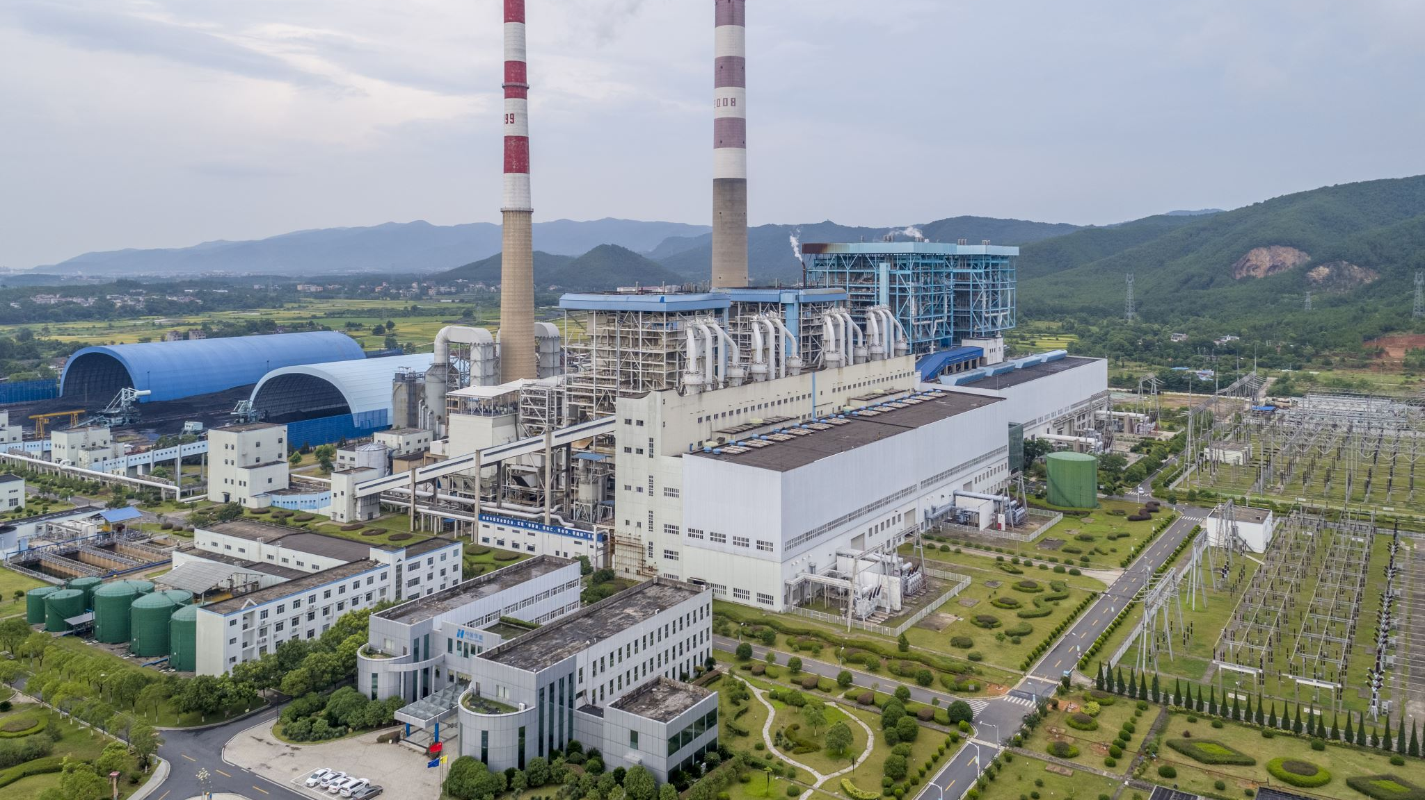
GHG Emissions & effects
Greenhouse gas (GHG) emissions trap heat in the Earth's atmosphere and contribute to climate change.
The most common GHGs are carbon dioxide (CO2), methane (CH4), and nitrous oxide (N2O).
Human activities, such as burning fossil fuels for energy and transportation, agriculture and land use changes,, industrial processes and household activities have significantly increased the amount of GHGs in the atmosphere.
As GHGs accumulate, they trap more heat from the sun, leading to a gradual increase in the Earth's temperature.
This phenomenon, known as global warming, has numerous negative effects on the environment, including rising sea levels, more frequent and severe weather events, and altered ecosystems.
Climate change, which is the long-term effect of increased GHG emissions, can have serious impacts on human health and the economy, and can lead to food and water shortages, displacement of communities, and loss of biodiversity.
Reducing GHG emissions is essential to mitigating the effects of climate change and ensuring a sustainable future for ourselves and future generations.

Slide 3

GHG Emissions From Housing
The housing sector is a significant contributor to greenhouse gas (GHG) emissions. Buildings, including homes, account for around 40% of global energy-related GHG emissions. The main sources of GHG emissions from housing are:
Energy Use
Building materials
Water Use
Waste

Slide 4
Overview OF the project
The project is about forecasting GHG emissions from housing across countries.
Climate change is one of the biggest challenges facing our planet today, and reducing GHG emissions from housing is essential to mitigating its effects.
The model developed in the project forecasts future emissions from housing by analyzing data patterns from previous years’ data.
The model provides policymakers with valuable information that can help them make informed decisions about how to reduce emissions from housing.
The project can help raise public awareness about the importance of reducing GHG emissions from housing.
By presenting the project's findings in an accessible way, people can understand the impact that their daily actions can have on the environment.
The project has the potential to make a real difference in the fight against climate change and work towards a more sustainable future for ourselves and for future generations.

Slide 5
Methodology
1. Data Collection
2. Data pre-processing
3. Feature engineering
4. Model Selection
5. Model Training
6. Model Evaluation
7. Hyperparameter tuning
8. Extraction of results
9. Visualizations Creation

Slide 6
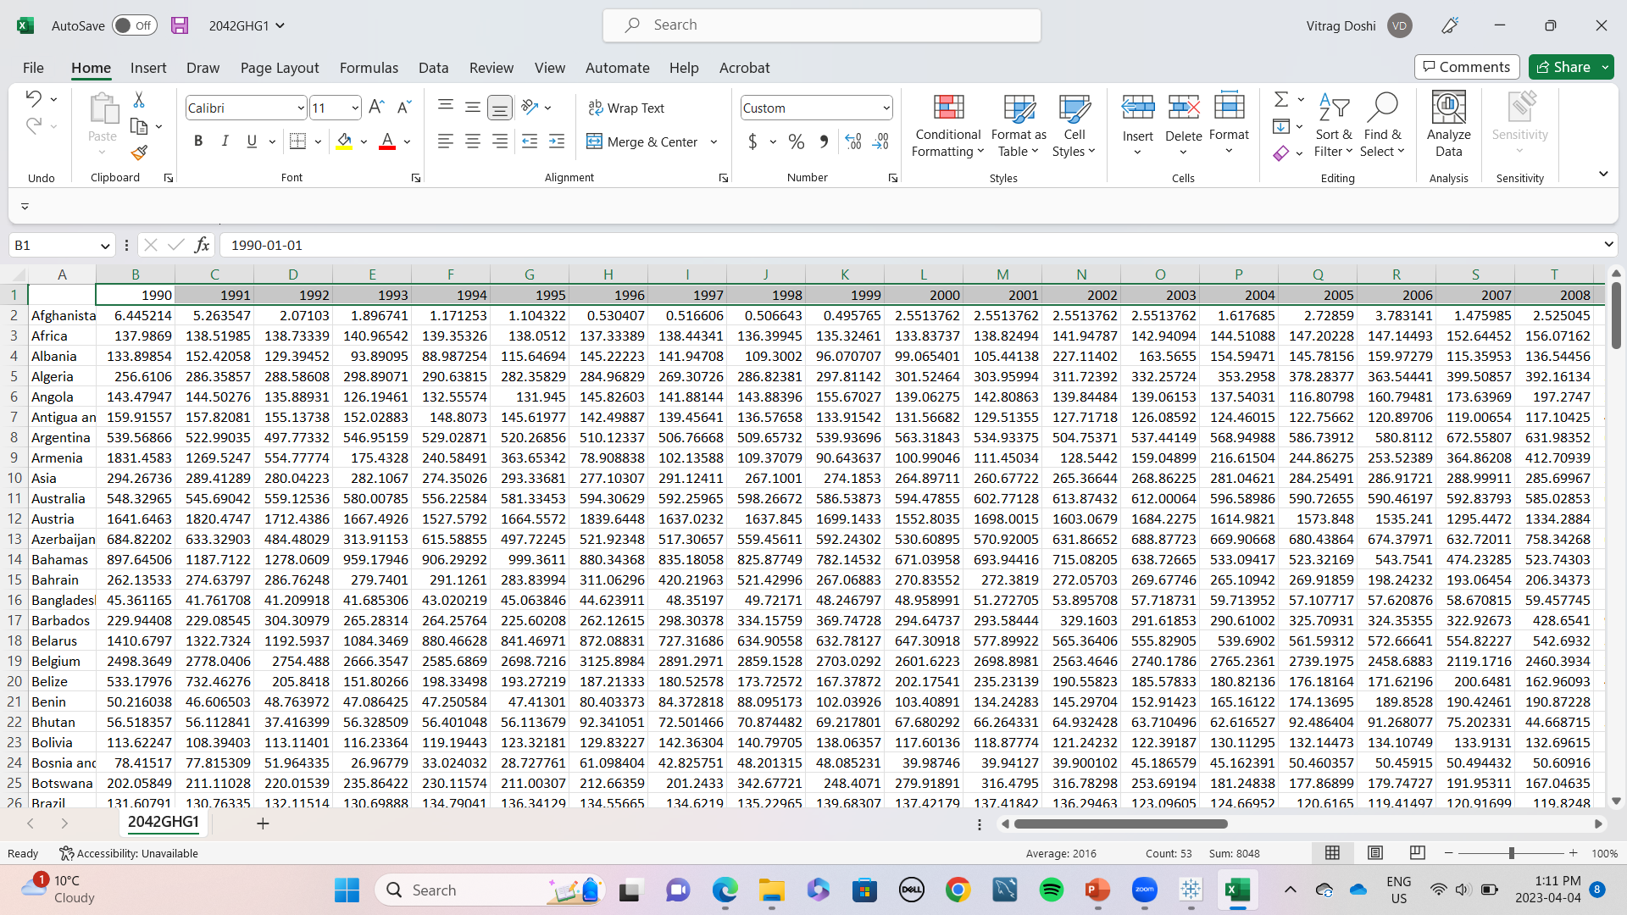
Data SourceS
https://ourworldindata.org/co2-and-greenhouse-gas-emissions
https://ourworldindata.org/emissions-by-sector

Slide 7
ARIMA Model
Auto Regressive Integrated Moving Average
ARIMA is a statistical method used to analyze time series data.
The model looks at the correlation between past and present data to make predictions about future data points.
It considers the overall trend or direction of the data.
The model uses a moving average to smooth out fluctuations and provide accurate predictions for future data points.
ARIMA is commonly used for forecasting in various fields, such as finance, economics, and environmental science.
The model assumes that the future will be similar to the past, which is often a reasonable assumption for many types of data.
ARIMA can be a useful tool for identifying trends, making predictions, and informing decision-making based on time series data.

Slide 8
Limitations
The accuracy of the model depends on the quality and completeness of the input data. Any errors, missing data, or outliers in the data can affect the accuracy of the predictions.
The model assumes that the relationships and patterns observed in the historical data will continue, which may not always be the case.
The model assumes that external factors, such as economic growth, population changes, and technological advancements, will remain constant, which may not be the case.

Slide 9
Future Applications:
The model could be used to inform policy decisions aimed at reducing GHG emissions from the housing sector.
The model could be used to identify countries or regions with high GHG emissions from the housing sector and prioritize efforts to reduce those emissions.
The model could be adapted to other sectors or industries to forecast GHG emissions and inform climate action plans.

Slide 10
Improvements:
The model can be improved by incorporating more comprehensive and accurate data, including data on energy consumption, building materials, and population growth.
The model can be adapted to include more complex variables, such as economic indicators and climate patterns, to better capture the underlying factors driving GHG emissions.
The model could be validated and tested against actual emissions data to improve its accuracy and identify any weaknesses or errors in the model.
The model could be further developed to account for regional differences in building practices, energy sources, and climate conditions.

Slide 11
Conclusion
In conclusion, we have seen how the housing sector contributes significantly to global GHG emissions, and the importance of forecasting these emissions in order to inform climate action plans and reduce our impact on the environment. Using the ARIMA model and data collected from past years, we were able to forecast GHG emissions from the housing sector across countries up to 2042 and visualize our predictions in a way that can inform policy decisions.
As we move forward, it is essential that we continue to work towards reducing GHG emissions from the housing sector and other sources. Everyone can make a difference in their own lives by making small changes, such as reducing energy consumption and waste, choosing sustainable building materials, and advocating for policies that support a sustainable future.

Slide 12
Recommendation
Implement building codes and standards that require new and existing buildings to be more energy-efficient and to use renewable energy sources.
Offer financial incentives such as tax credits, grants or subsidies to households that invest in energy-efficient appliances, solar panels or other renewable energy technologies.
Set mandatory emissions reduction targets for the housing sector and require households to report their energy consumption and emissions.
Encourage sustainable transportation options such as electric vehicles, bike lanes, and public transportation.
Increase public awareness through education campaigns and outreach programs to encourage households to adopt sustainable practices and reduce their energy consumption.

Slide 13

OUR KEY Wins
Developed valuable skills – Collaborated within our team, Communication, Team-work, Technical Skills, Problem Solving.
Got to study and gain knowledge and insights towards GHG emissions, Global warming, Climate Change and Global positions on the issue.

Slide 14
References
Why the built environment? Architecture 2030. (n.d.). Retrieved April 4, 2023, from https://architecture2030.org/why-the-building-sector/#:~:text=The%20built%20environment%20generates%2040,for%20an%20additional%2013%25%20annually
Hayes, A. (2023, January 5). Autoregressive integrated moving average (ARIMA) prediction model. Investopedia. Retrieved April 4, 2023, from https://www.investopedia.com/terms/a/autoregressive-integrated-moving-average-arima.asp#:~:text=An%20autoregressive%20integrated%20moving%20average%2C%20or%20ARIMA%2C%20is%20a%20statistical,values%20based%20on%20past%20values
Ritchie, H., Roser, M., & Rosado, P. (2020, May 11). CO₂ and greenhouse gas emissions. Our World in Data. Retrieved April 4, 2023, from https://ourworldindata.org/co2-and-greenhouse-gas-emissions
Ritchie, H., Roser, M., & Rosado, P. (2020, May 11). Emissions by sector. Our World in Data. Retrieved April 4, 2023, from https://ourworldindata.org/emissions-by-sector
Druckman, A., & Jackson, T. (1970, January 1). Understanding households as drivers of carbon emissions. SpringerLink. Retrieved April 4, 2023, from https://link.springer.com/chapter/10.1007/978-3-319-20571-7_9

Slide 15
Thank you
We look forward to your questions

